Slide 1
Analyzing the Neighborhoods in Jaipur for Starting a Restaurant
Applied Data Science Capstone Project
By: Samiksha Gupta
Date: May 23, 2021

Slide 2
1. Introduction
Jaipur is the capital and the largest city of the Indian state of Rajasthan. As of 2011, the city had a population of 3.1 million, making it the tenth most populous city in the country. Jaipur is also known as the Pink City, due to the dominant color scheme of its buildings. It is located 268 km (167 miles) from the national capital New Delhi.
Jaipur is a popular tourist destination in India and forms a part of the west Golden Triangle tourist circuit along with Delhi and Agra. It also serves as a gateway to other tourist destinations in Rajasthan such as Jodhpur, Jaisalmer, Udaipur, Kota, and Mount Abu. Jaipur is located 616 km from Shimla.

Slide 3
the aim of this project is to study the neighborhoods in Jaipur to determine possible locations for opening a restaurant. This project can be useful for business owners and entrepreneurs who are looking to invest in a restaurant in Jaipur. The main objective of this project is to carefully analyze appropriate data and find recommendations for the stakeholders

Slide 4
2. Data Collection
The data required for this project is collected from various resources. The data and their source is described below
2.1 Neighborhoods Data:The neighborhood or location data is scrapped from website https://www.zricks.com/Locality/Jaipur .
2.2 Geographical Coordinates:The geographical coordinates of the neighborhoods are obtained from GeoPy library in Python.
2.3 Venues Data:The venue data has been extracted using the Foursquare API.

Slide 5
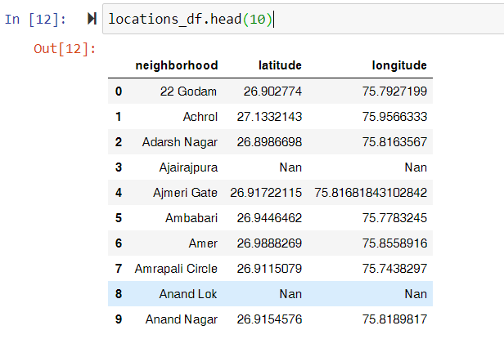
Jaipur Locations Data

Slide 6
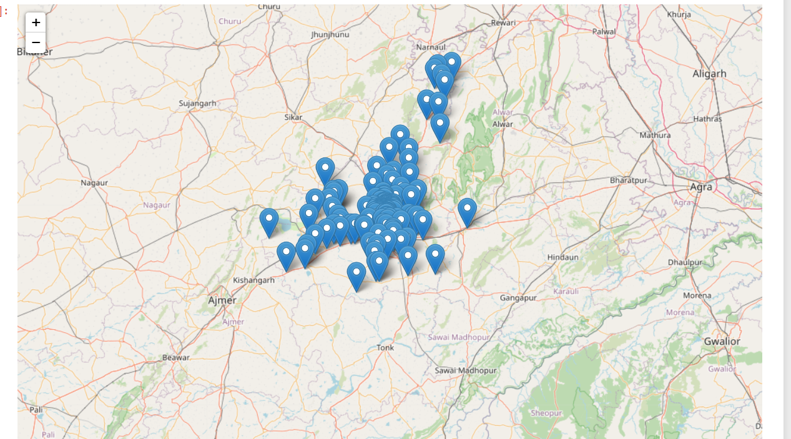
Visualization of data on map

Slide 7
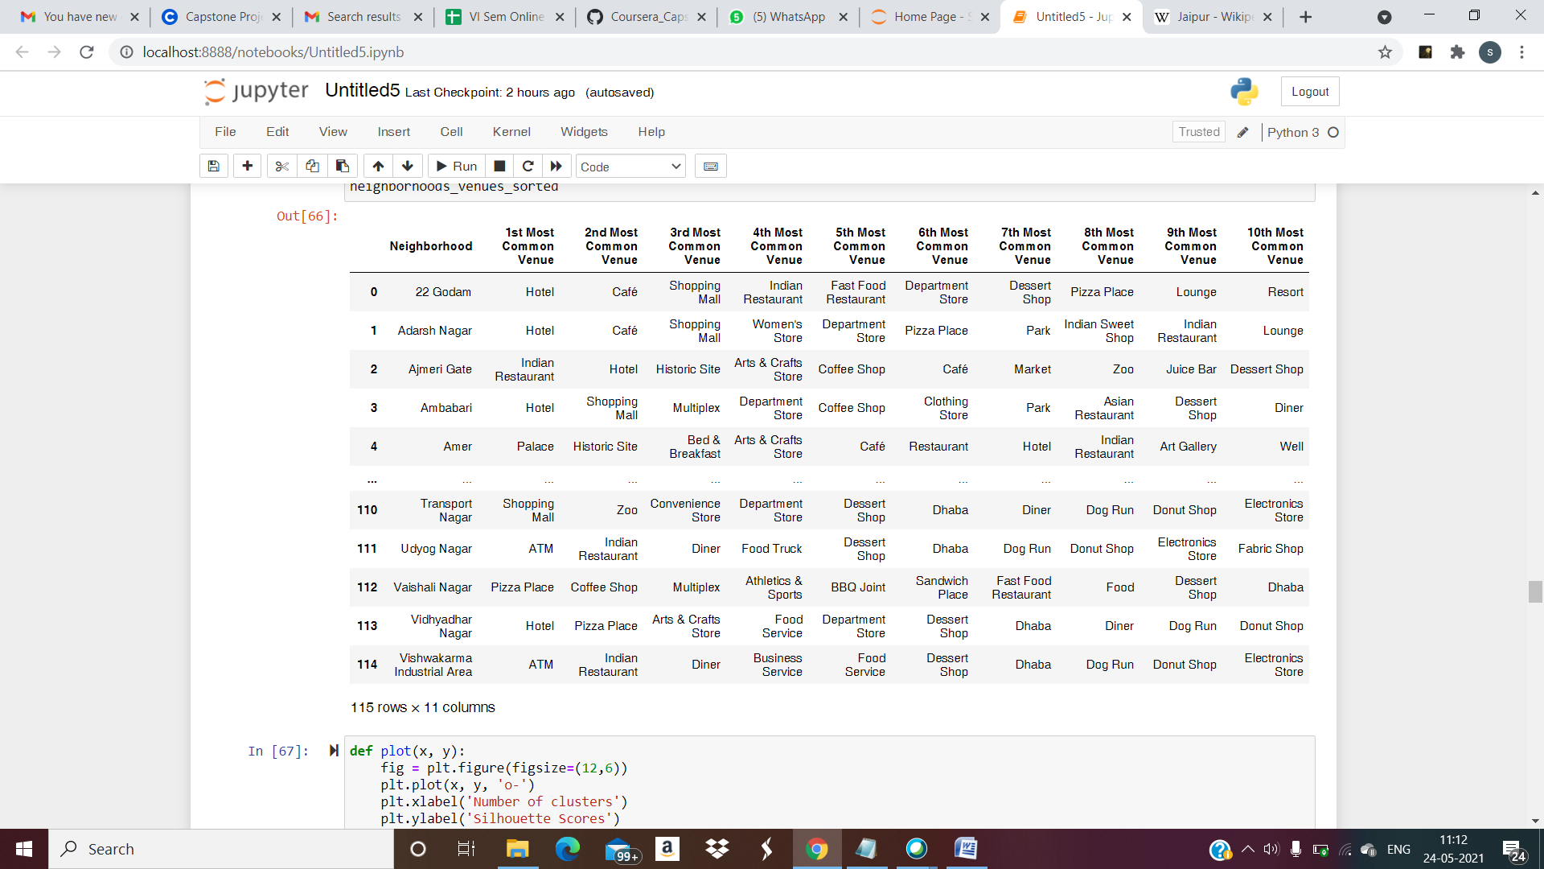
3. Methodology
3.1 Feature Extraction:Feature extraction was carried out to obtain features from the Foursquare API data which was used for building the unsupervised learning model.
Top 10 venues for each location.

Slide 8
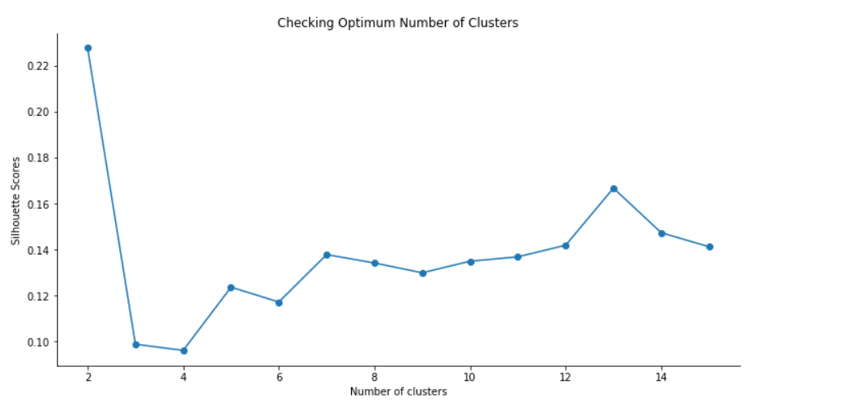
4. Model Tranning
Now we can use KMeans clustering method to cluster the neighborhoods.First we need to determine how many clusters to use. This will be done using the Silhouette Score.We will define a function to plot the Silhouette Score that will be calculated using different number of clusters.

Slide 9
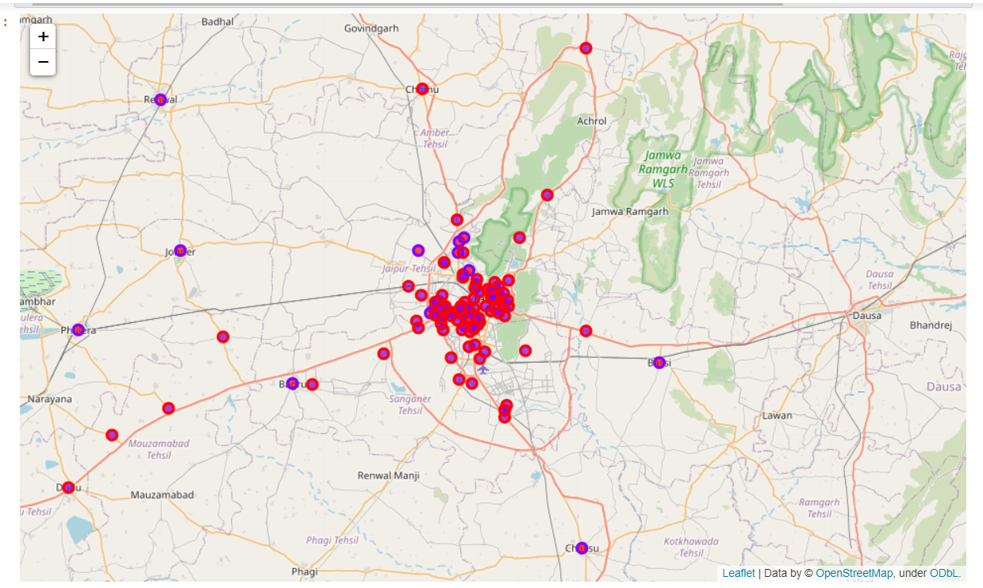
5. Result
The K means model generate clusters of dataset in two categories and label them as 0 and 1. They can be visualized by plotting them onto a map using Folium library.

Slide 10
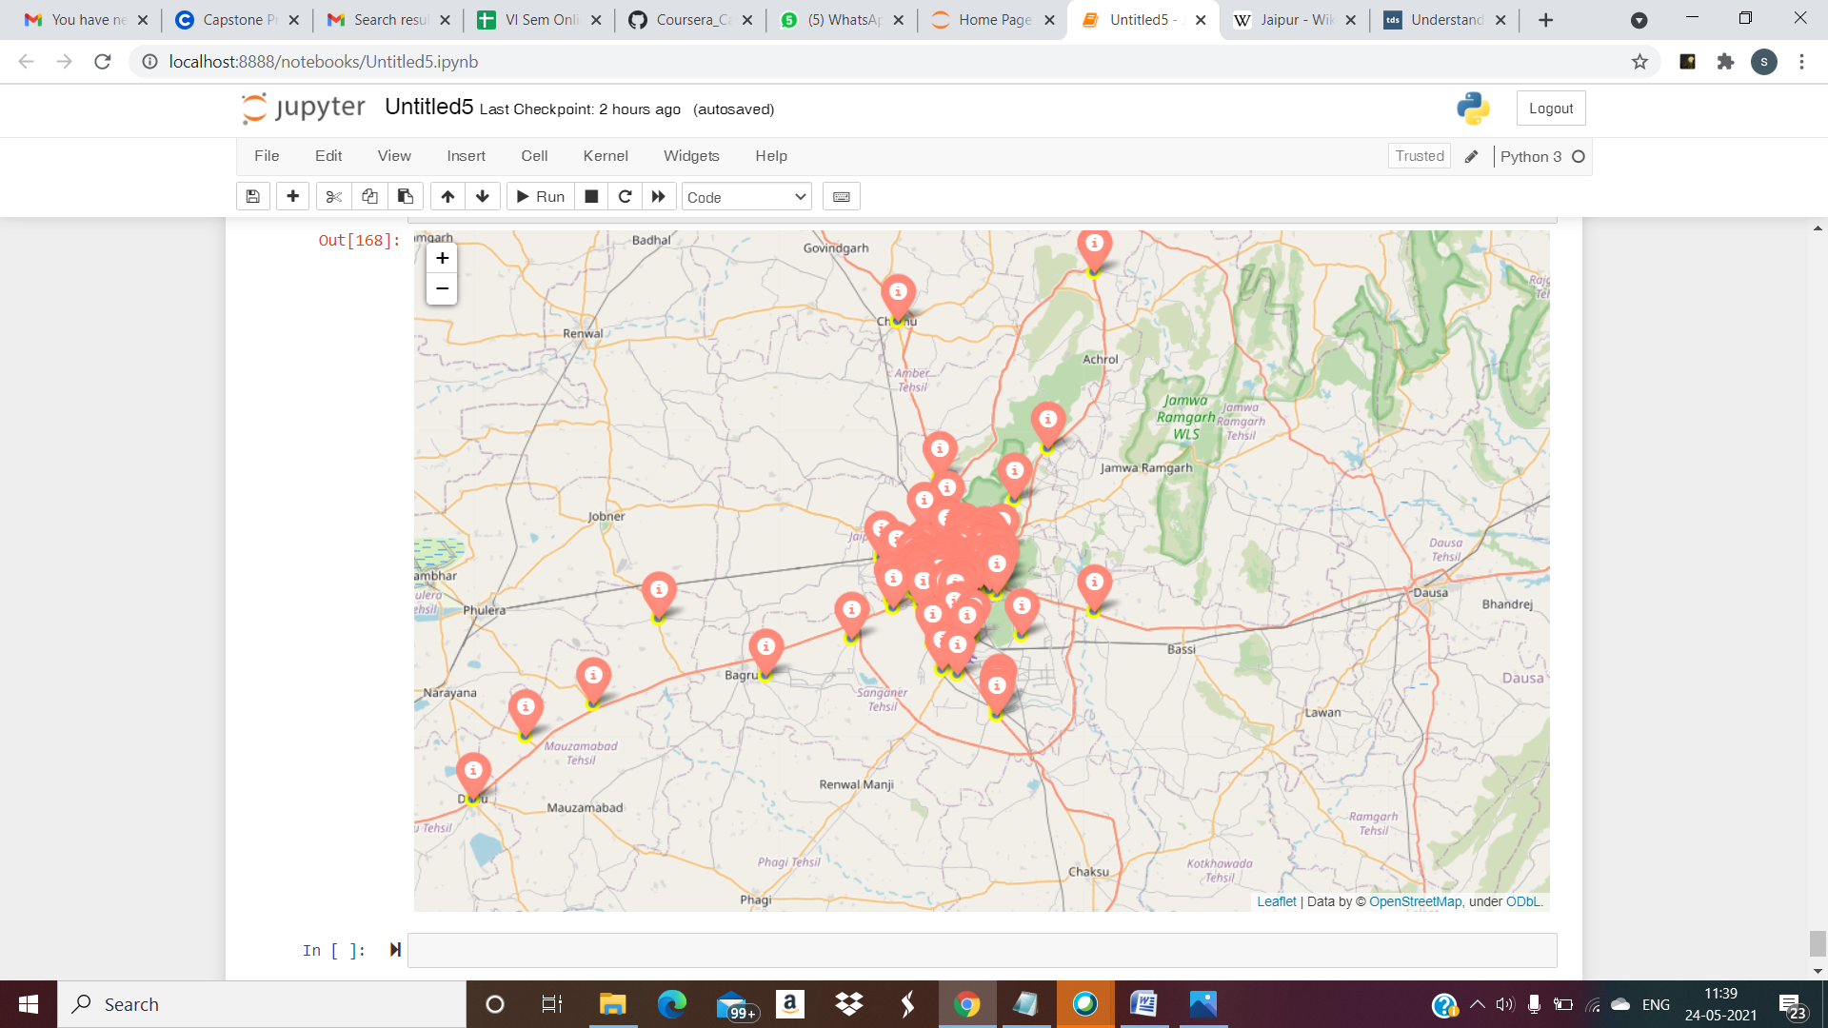
6. Conclusion
The neighborhoods in cluster having level 1 contain a variety of food joints like restaurants, tea rooms, bakery, cafe, steakhouse and pubs and also contain very diverse cuisines like Japanese, Indian, Chinese, Italian and seafood restaurants. So it is more suitable for opening a restaurant.

